Slide 1
Chapter 7 System software 7.4 translators

Slide 2
Syllabus
show an understanding of the need for:
assembler software for the translation of an assembly language program
a compiler for the translation of a high-level language program
an interpreter for execution of a high-level language program
explain the benefits and drawbacks of using either a compiler or interpreter
show awareness明白 that high-level language programs may be partially compiled and partially interpreted, such as Java

Slide 3
Low Level Languages
Instructions are either in machine code or assembly language
Low-level languages have high execution efficiency and fast speed
They do not have processes such as compilation and analysis, and the program directly controls the hardware, which is relatively efficient, but it is difficult to learn and debug, and programming is slow.

Slide 4
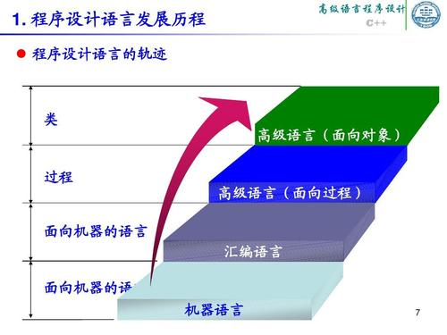

Slide 5
High - Level Languages (HLL)
High-level languages are programming languages that are closer to the logic of human language and rely on compilation. Its development efficiency is higher and it is relatively easy to learn; but its implementation efficiency is low.
FORTRAN (Formula(公式) Translation)
Python
Java
C++

Slide 6
Differences between LLL and HLL

Slide 7
Translators
Compilers 编译器
A compiler is a computer program that translates a program written in a high-level language (HLL) into machine code
Assemblers 低级编码器
An assembler is a computer program that translates a program written in an assembly language into machine code
Interpreters 解释器
An interpreter is a computer program that reads a line code from a program written in a HLL, performs the action specified(指定的) by the codes and then does the same with the next line code

Slide 8
Difference
The interpreter needs to be interpreted解释 and executed at run time. However, the compiler is not needed at runtime.

Slide 9
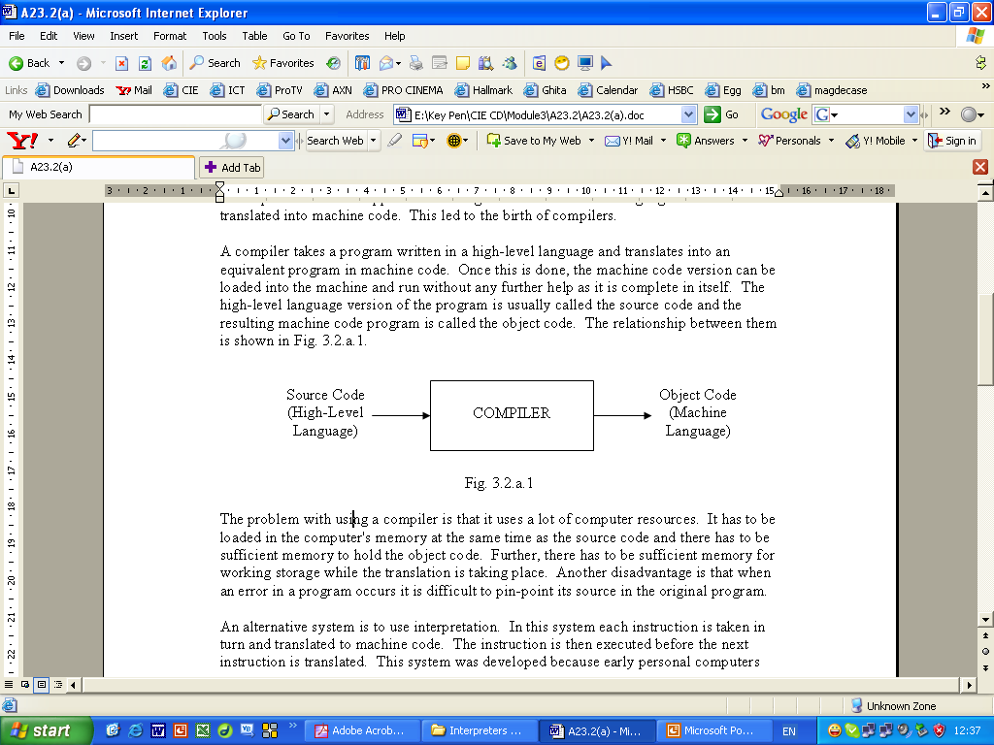
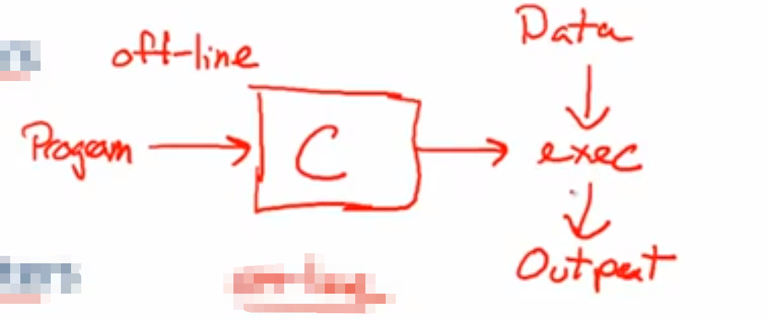
Compiler
Translate high-level languages into machine code.
The machine code version can be loaded into the machine and run .
The high-level language version of the program is called the source code(源代码) and the resulting machine code program is called the object code(目标代码).

Slide 10
Advantages of using a Compiler
A compiler creates object code - that is, an executable file.
Compiled programs execute faster than interpreted code.
The compiler software is not needed at runtime, once compiled, no further translation is needed.
If a program contains loops, the compiler will need to translate this section of code once only.

Slide 11
Disadvantages of using a Compiler
The source code must be 100% correct for the executable file to be produced.
Object code needs to be produced before a final executable file, this can be a slow process.

Slide 12
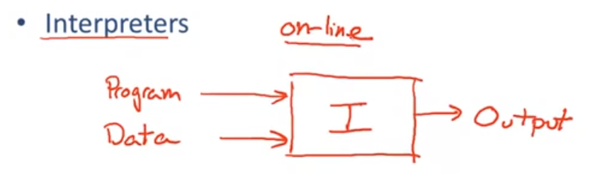
Interpreters
Take each instruction in turn and translates it into machine code.
Executes the translated instruction before the next instruction is translated.
An interpreter program executes other programs directly, running through program code and executing it line-by-line.

Slide 13
Advantages of using an Interpreters
Interpreted code makes for easier debugging.
An interpreter allows an attempted execution of the program at any stage in its development.
An interpreter allows for testing parts of a program before all the code is written.

Slide 14
Disadvantages of using an Interpreters
The biggest disadvantage is slow speed. Interpreted code runs slower than compiled code.
This is because the interpreter has to analyse(分析) and convert each line of source code into machine code before it can be executed.

Slide 15
Assembler
An assembler translates assembly language into machine code.
Assembly language consists of mnemonics(/ni'mɑnɪks/助记符) for machine opcodes and operands.
So assemblers perform a corresponding translation from mnemonic to a direct instruction.
For example:
LDA #4 converts to 0001001000100100

Slide 16
Advantages of using an Assembler
Very fast in translating assembly language to machine code as 1 to 1 relationship
Assembly code is often very efficient (and therefore fast) because it is a low level language
Assembly code is easy to understand due to the use of English-like mnemonics

Slide 17
Disadvantages of using an Assembler
The language is verbose(冗长的) and quite inexpressive(lack of meanings), lacking the data structures .
Errors can be difficult to detection and often cause the program to crash unpredictably.

Slide 18
Summary of translation
Compiler | Interpreter | Assembler
Translates the whole of the source code in one go, if there are any errors in the code it will not compile | Translates the source code into machine code one line at a time, if there are errors, they will be detected. | Translates the low-level language program into machine code
An executable file of machine code is produced | No executable file of machine code is produced | An executable file of machine code is produced
An executable file can be distributed to users so the users have no access to the source code | When a program is error free, the source code has to be sent to each user
Compiled object code will provide faster execution | Errors can be identified as they occur and corrected immediately without having to wait for the whole of the source code to be read and analysed.
Compiled object code is less secure because it could contain a virus | Parts of the code which contain syntax errors may not be discovered until later

Slide 19
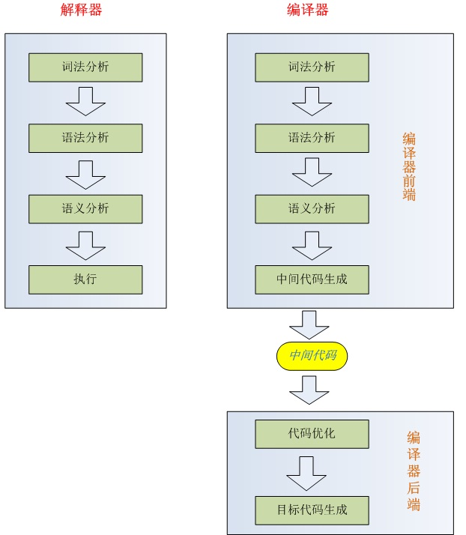

Slide 20
Java
For C and C ++, they can be directly executed by the operating system after one compilation, so they are compiled languages.
Java is not the same. It is first compiled by the compiler into a '.class' file, and then read from the '.class' file through the JVM(Java Virtual Machine, Java虚拟机) to interpret and execute one line, so it is an interpreted language.
Machine independent: It is also because Java has different JVMs for many different operating systems, so it achieves true cross-platform(跨平台).

Slide 21
Translated process
Java uses a two-step translation process
Java code is partially interpreted – partially compiled
Code is translated first into intermediate code / "bytecode“ by using the Java compiler
The bytecode is finally interpreted by the Java Virtual Machine

